Slide 1
Lecture #0
Machine Learning Algorithms
(INT417)

Slide 2
Which of the following component is responsible for learning in a artificial neuron?
Activation function
Bias
Weights
All of the mentioned

Slide 3
Suppose a perceptron model with 3 inputs [1,1,0] and 1 output and threshold=2. If weights are [2, 3, 1] and bias = -2, what will be the output of the model?
1
2
0
None of these.

Slide 4
Consider a multilayer neural network having 1 input layer, 1 hidden layer and 1 output layer. Number of neurons at input layer, hidden layer and output layer are 3, 3 and 1 respectively. How many total weights and bias values are there in the model.
12
15
18
16

Slide 5
Course Overview
L T P :
Text Books:
MACHINE LEARNING by THOMAS MITCHELL, MCGRAW HILL EDUCATION
References:
1. PATTERN CLASSIFICATION by RICHARD O. DUDA, PETER E. HART, DAVID G. STORK, WILEY
3 | 0 | 0

Slide 6


Slide 7
Course Objectives
Through this course students should be able to
categorize the machine learning problems based on learning rules.
apply the key concepts that form the core of machine learning.
develop the key algorithms for the system that are intelligent enough to make the decisions.
contrast the statistical, computational and game-theoretic models for learning

Slide 8
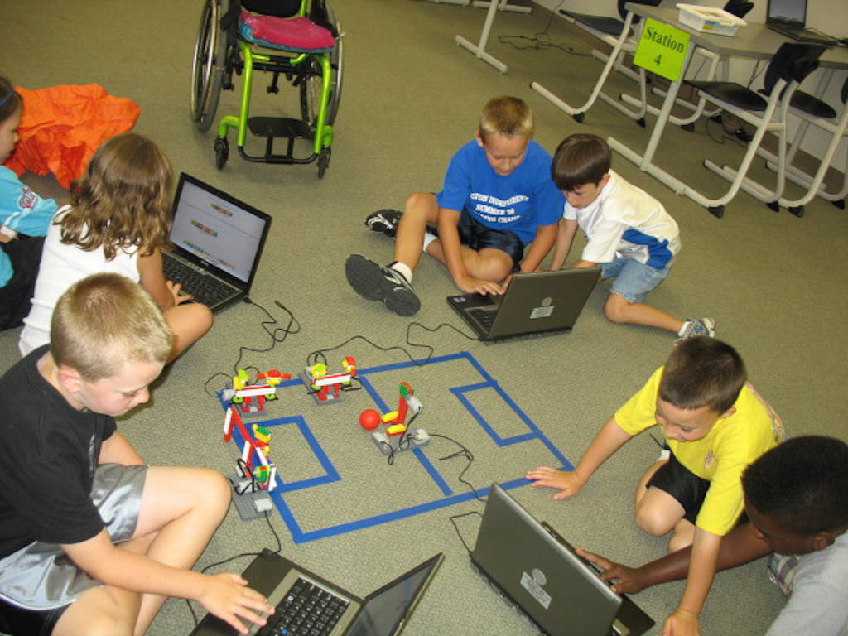
Application
Entertainment

Slide 9

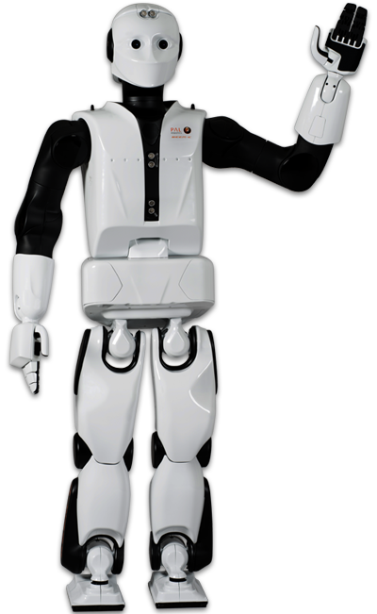
Application
Intelligent Robots

Slide 10
Unit 1
Introduction to machine learning : learning, need of machine learning, types of learning, well-posed learning problems, designing a learning systems, issues in machine learning
Formal learning model : statistical learning framework, empirical risk minimization, empirical risk minimization with inductive bias, PAC learning, general learning model

Slide 11
Unit 2
Decision tree learning : decision tree representation, appropriate problem for decision tree learning, CART, ID3, C4.5, information gain measure, inductive bias in decision tree, minimum description length, Issues in decision tree learning, random forest

Slide 12
Syllabus
Unit 3
Generative models : maximum likelihood estimator, naive Bayes, EM Algorithm, Bayesian learning,
Bayes theorem, Bayesian decision theory, brute-force concept learning, minimum error rate
classification, discriminant function, Bayes optimal classifier, gibs algorithm, Bayesian belief network

Slide 13
Syllabus
Unit 4
Complex prediction problems : one-versus-all, all-pairs, linear multiclass predictors, multiclass
SVM and SGD, structured output predictions, ranking, multivariate performance measure
Nonparametric Methods : Density estimation, parzen window, the nearest neighbour rule, Knearest neighbour estimation.

Slide 14
Syllabus
Unit 5
The bias-complexity tradeoff : no free lunch theorem, error decomposition, the VC-Dimension, surrogate loss functions, the Rademacher complexity, the Natarajan dimension
Nonuniform learnability : learning via uniform convergence, characterizing nonuniform learnability,
structural risk minimization, minimum description length, different notions of learnability, computational complexity of learning

Slide 15
Syllabus
Unit 6
Algorithm-Independent machine Learning : combining classifiers, re-sampling for estimating statistics, lack of inherent superiority of classifier, comparing and estimating classifiers
Reinforcement learning : the learning task, Q learning, nondeterministic rewards and action, temporal difference learning

Slide 16
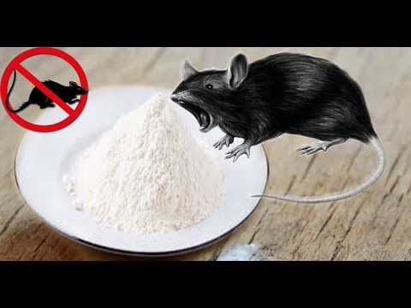
What Is Learning?
Rat Bait Shyness
  Rats Learning to Avoid Poisonous Baits
Notes:
When rats encounter
food items with novel look or smell, they will first eat very small amounts, and
subsequent feeding will depend on the flavor of the food and its physiological
effect. If the food produces an ill effect, the novel food will often be associated
with the illness, and subsequently, the rats will not eat it. Clearly, there is a
learning mechanism in play here { the animal used past experience with some
food to acquire expertise in detecting the safety of this food. If past experience
with the food was negatively labeled, the animal predicts that it will also have
a negative effect when encountered in the future.

Slide 17
learning by memorization
Suppose we would like to program a machine that learns how to filter spam e-mails.
  The machine will simply memorize all previous e-mails that had been labeled as spam e-mails by the human user. When a new e-mail arrives, the machine will search for it in the set of previous spam e-mails. If it matches one of them, it will be trashed. Otherwise, it will be moved to the user’s inbox folder
  it lacks an important aspect of learning systems
    the ability to label unseen e-mail messages.
Notes:
When rats encounter
food items with novel look or smell, they will first eat very small amounts, and
subsequent feeding will depend on the flavor of the food and its physiological
effect. If the food produces an ill effect, the novel food will often be associated
with the illness, and subsequently, the rats will not eat it. Clearly, there is a
learning mechanism in play here { the animal used past experience with some
food to acquire expertise in detecting the safety of this food. If past experience
with the food was negatively labeled, the animal predicts that it will also have
a negative effect when encountered in the future.

Slide 18
Generalization
A successful learner should be able to progress from individual
examples to broader generalization. This is also referred to as inductive reasoning or inductive inference.
  bait shyness example presented previously, after the rats encounter an example of a certain type of food, they apply their attitude toward it on new, unseen examples of food of similar smell and taste
  spam filtering task, the learner can scan the previously seen
  e-mails, and extract a set of words whose appearance in an e-mail message is
  indicative of spam. Then, when a new e-mail arrives, the machine can check whether one of the suspicious words appears in it, and predict its label accordingly.

Slide 19
What distinguishes learning mechanisms that result in superstition from useful learning?
  This question is crucial to the development of automated learners.
    While human learners can rely on common sense to filter out random meaningless
    learning conclusions, once we export the task of learning to a machine, we must
    provide well defined crisp principles that will protect the program from reaching
    senseless or useless conclusions.
    The development of such principles is a central goal of the theory of machine learning.

Slide 20
Inductive Bias
We conclude that one distinguishing feature in the bait shyness learning is the incorporation of prior knowledge that biases
the learning mechanism. This is also referred to as inductive bias.
The rats’ learning process is biased toward detecting some kind of
patterns while ignoring other temporal correlations between events.

Slide 21
When Do We Need Machine Learning?
experience: the problem’s complexity
Tasks That Are Too Complex to Program.
  Tasks Performed by Animals/Humans:
    driving, speech recognition, and image understanding.
  Tasks beyond Human Capabilities:
    analysis of very large and complex data sets: astronomical data, turning
    medical archives into medical knowledge, weather prediction, analysis of genomic data, Web search engines, and electronic commerce.
Need for Adaptivity.
  programs that decode handwritten text, where a fixed program can adapt to variations between the handwriting of different users; spam detection programs, adapting automatically to changes in the nature of spam e-mails; and speech recognition programs.

Slide 22
Types of Learning
Supervised
Unsupervised
Reinforcement

Slide 24
More _____ the prior assumption in a system, ______ flexible the system will be.
stronger,less
Less,more
Less,less
None of the mentioned

Slide 25


